Slide 1

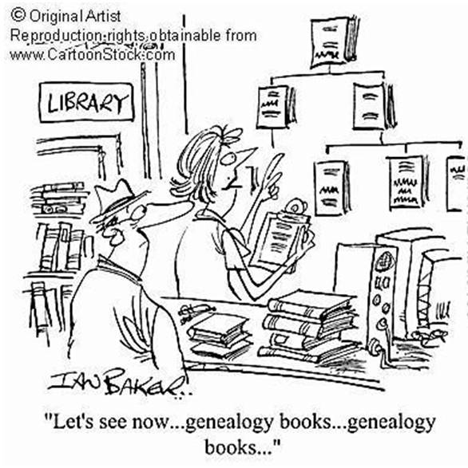
Natural Language Processing Genealogical extraction from Historical Documents
Lucky
Michael A. “Lucky” LaChance
5 minute Capstone Summary
Nashville Software School
June 3, 2020

Slide 2
5 Minute Agenda
The anticipated and actual journey
The process and method
Highlight Learning
A snapshot of the solution
The path ahead

Slide 3

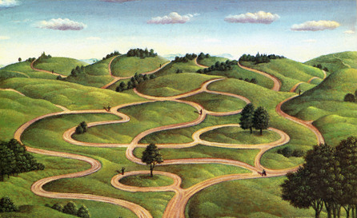
My Envisioned vs Actual Journey

Slide 4
The Process
Pre-Process
Process
Report
Extract Text from PDF Documents
Train the Computer
Import to Neo4J
Clean The Data
Validate Model
Analyze
Sentence Dataframe
Improve the model Model
Report
Mark the Relevent Sentences
Extract Relationship
From sentences
Feedback

Slide 5
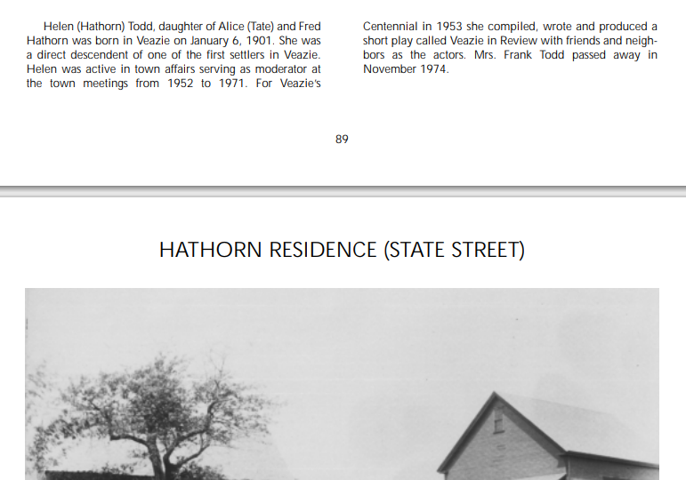
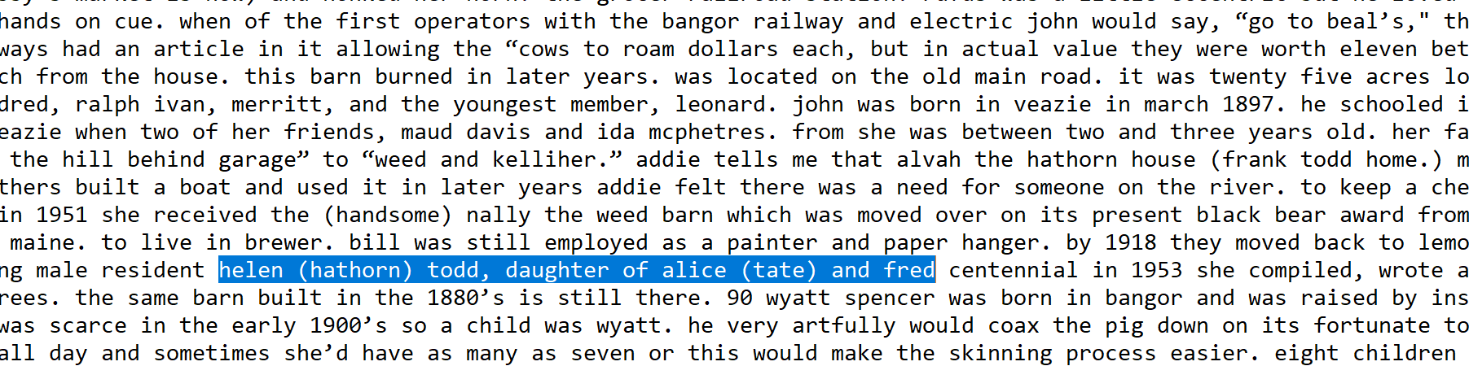
Post cleaning Human contextual review
Columns were treated as a space
…daughter of Alice (tate) and Fred –
…Centennial in 1953 she compiled, wrote…

Slide 6
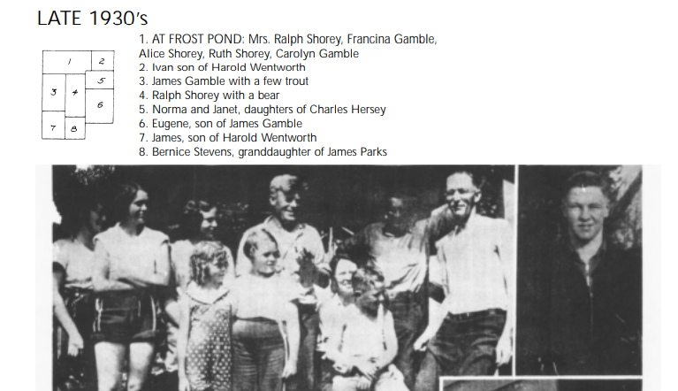
Semi-Structured - actually bad
Same Names in a picture no keyword

Slide 7
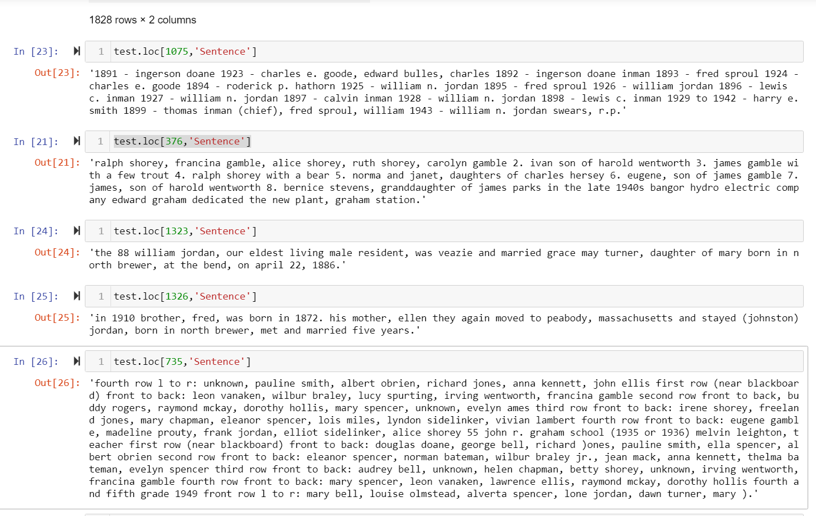
Top 5 Relevent Sentences
List of Names
Parent – Children - Grandchildren
Parent – Children
Sibling
Parent – Children
List of Names

